Slide 1
High Demand UBER Areas
Presentation Demo
Course: Cloud Computing
Sepideh Berangi(S3793021)
Mohammad Farshidmehr(S3308107)

Slide 2
High Demand UBER Areas
With our mobile app, the clients will be able to access their current location information or any specific part of the map, and it will display the demand rate of user requests based on the data provided by UBER. This information could be useful for UBER to identify the location of busy areas, for profiting more in their business. In addition, this data will be useful for the local government's traffic governance and the police to check the traffic flow of certain areas in order to improve their services.

Slide 3
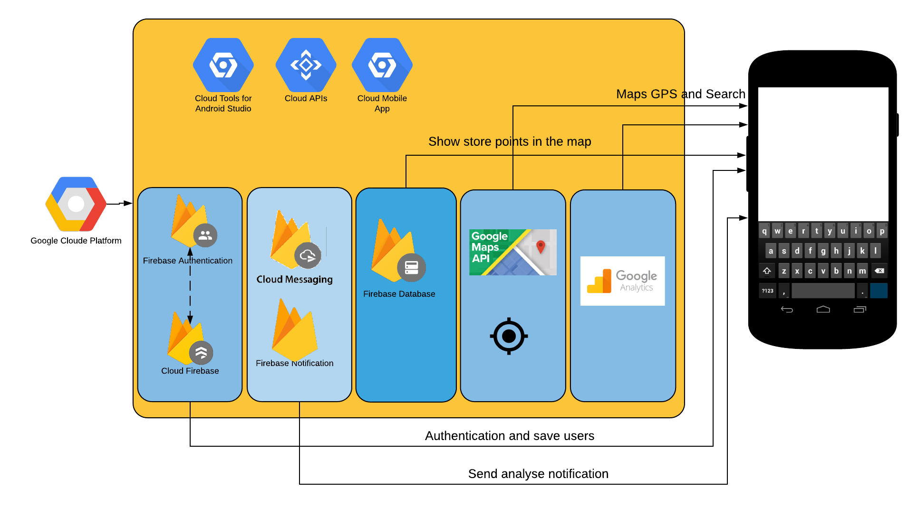
High Demand UBER Areas (Android)

Slide 4
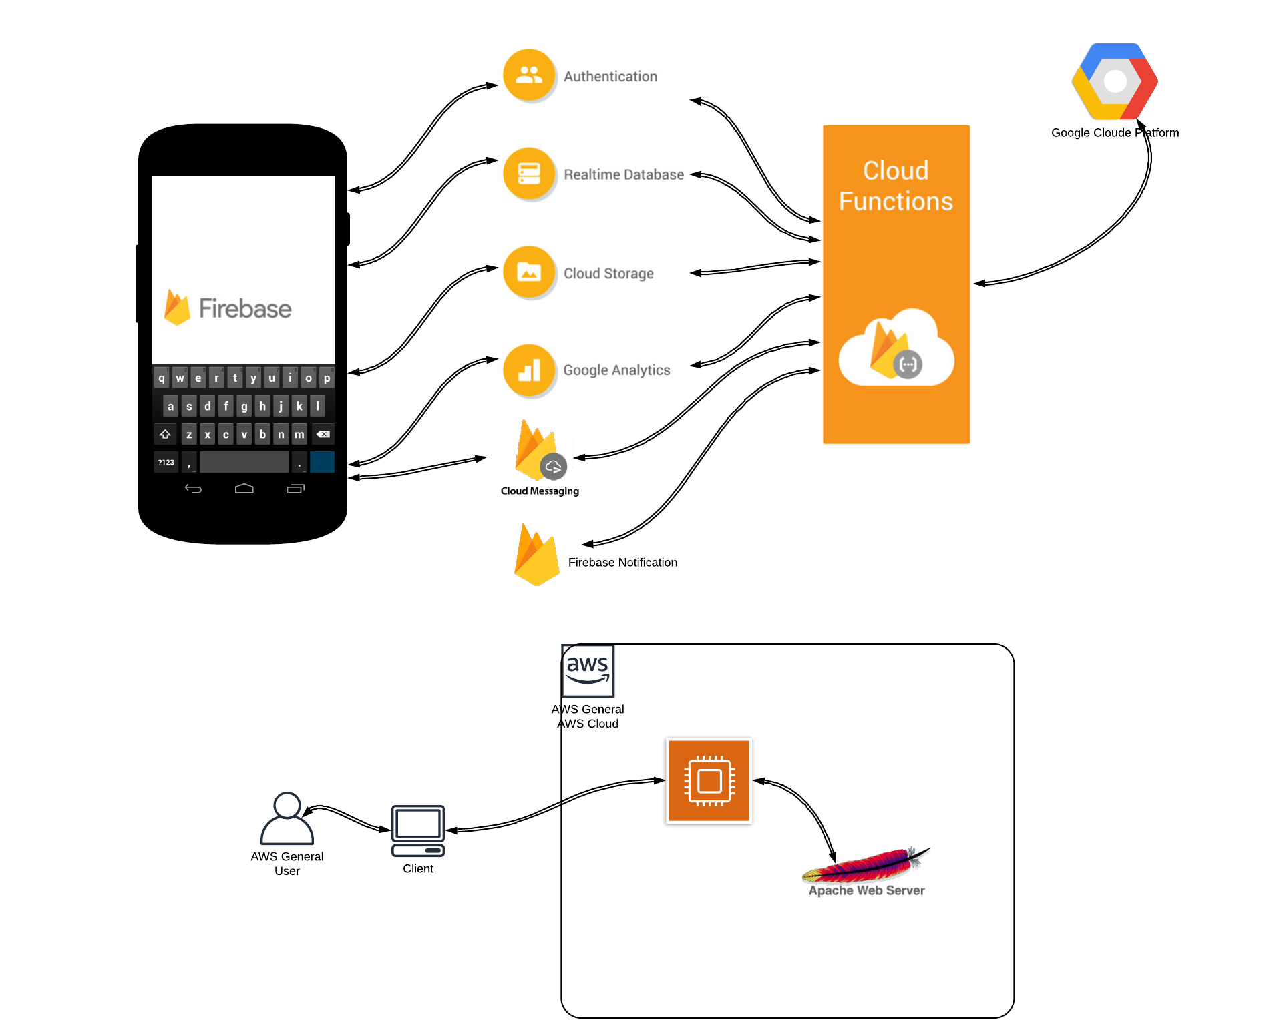
High Demand UBER Areas (Android Cont.)

Slide 5
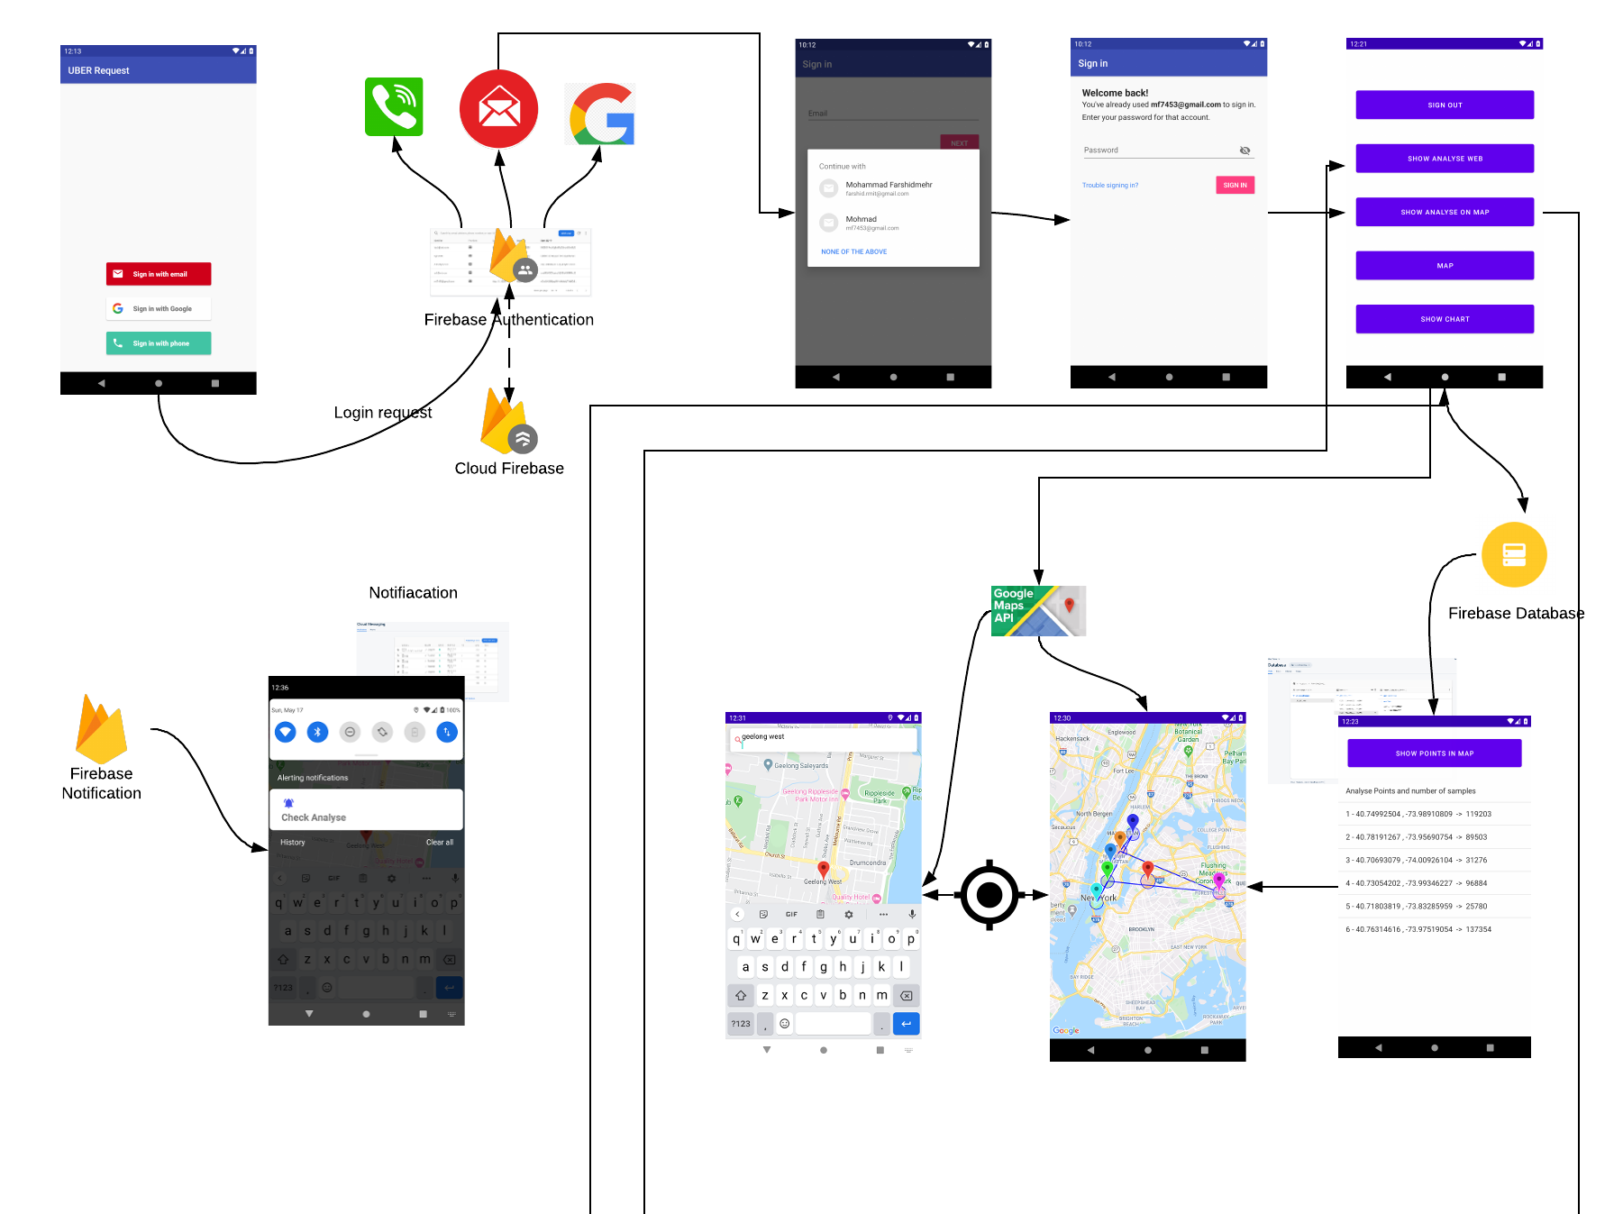
High Demand UBER Areas (Interface)

Slide 6
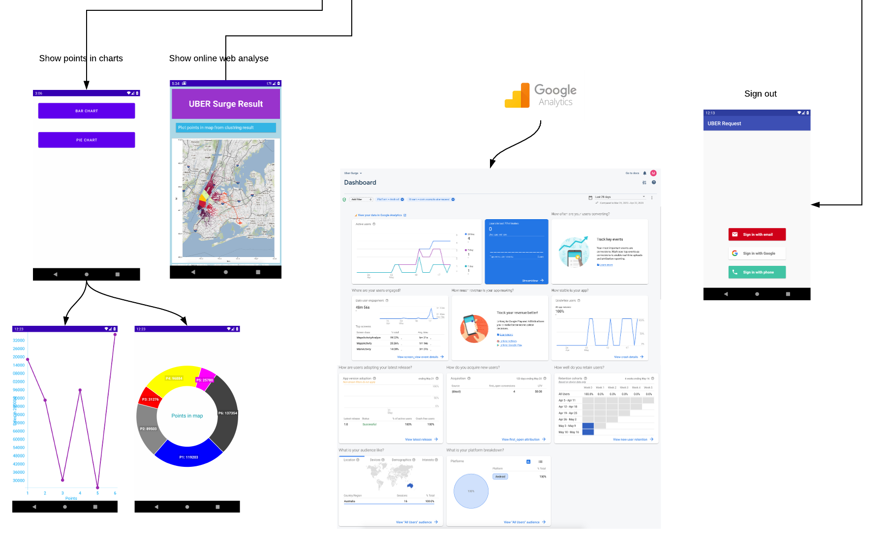
High Demand UBER Areas (Interface Cont.)

Slide 7
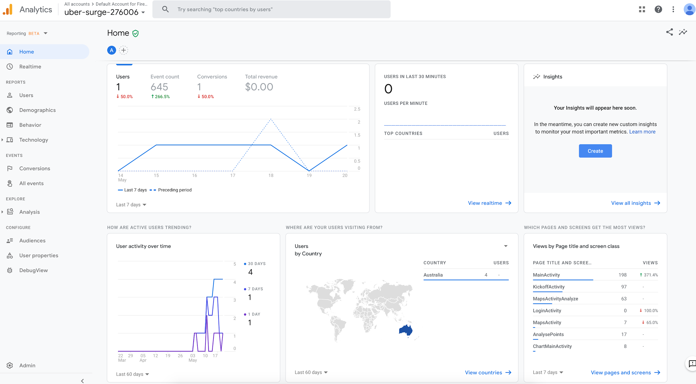

Slide 8
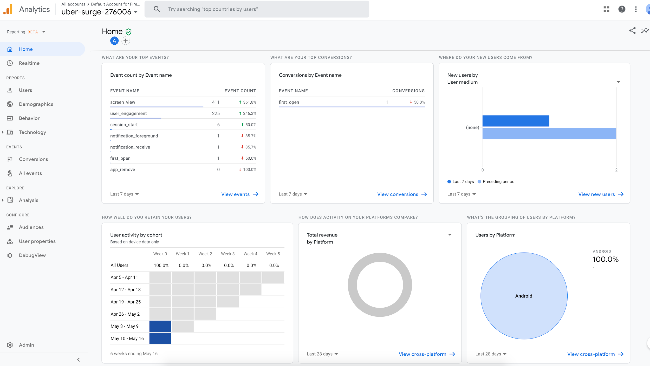

Slide 9
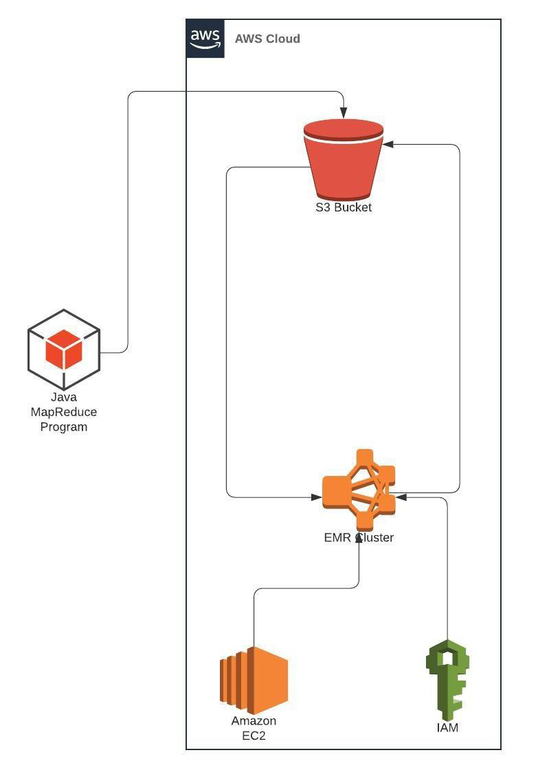
High Demand UBER Areas (AWS)

Slide 10
High Demand UBER Areas (AWS)
K-Means MapReduce
We have performed MapReduce on the K-means algorithm to be able to process our large scale data in order to identify the high-demand areas.
The original dataset was about 1GB which we reduced it to 22MBs
6 centroids are hard-coded at the beginning of the MapReduce task and by running the program, these 6 centroids will be converged to a fixed value, at the end.
Reads a text-file our from our s3 bucket and initiates the centroids with values, close to the real data point, and writes the output into a file named ”output.txt” in the output folder it creates in the s3 bucket.
Notes:
http://moore.vn/Uploads/files/2015/3/Moore-Vietnam-Digital-Landscape-2015.pdf
http://access.opennet.net/wp-content/uploads/2011/12/accesscontested-vietnam.pdf

Slide 11
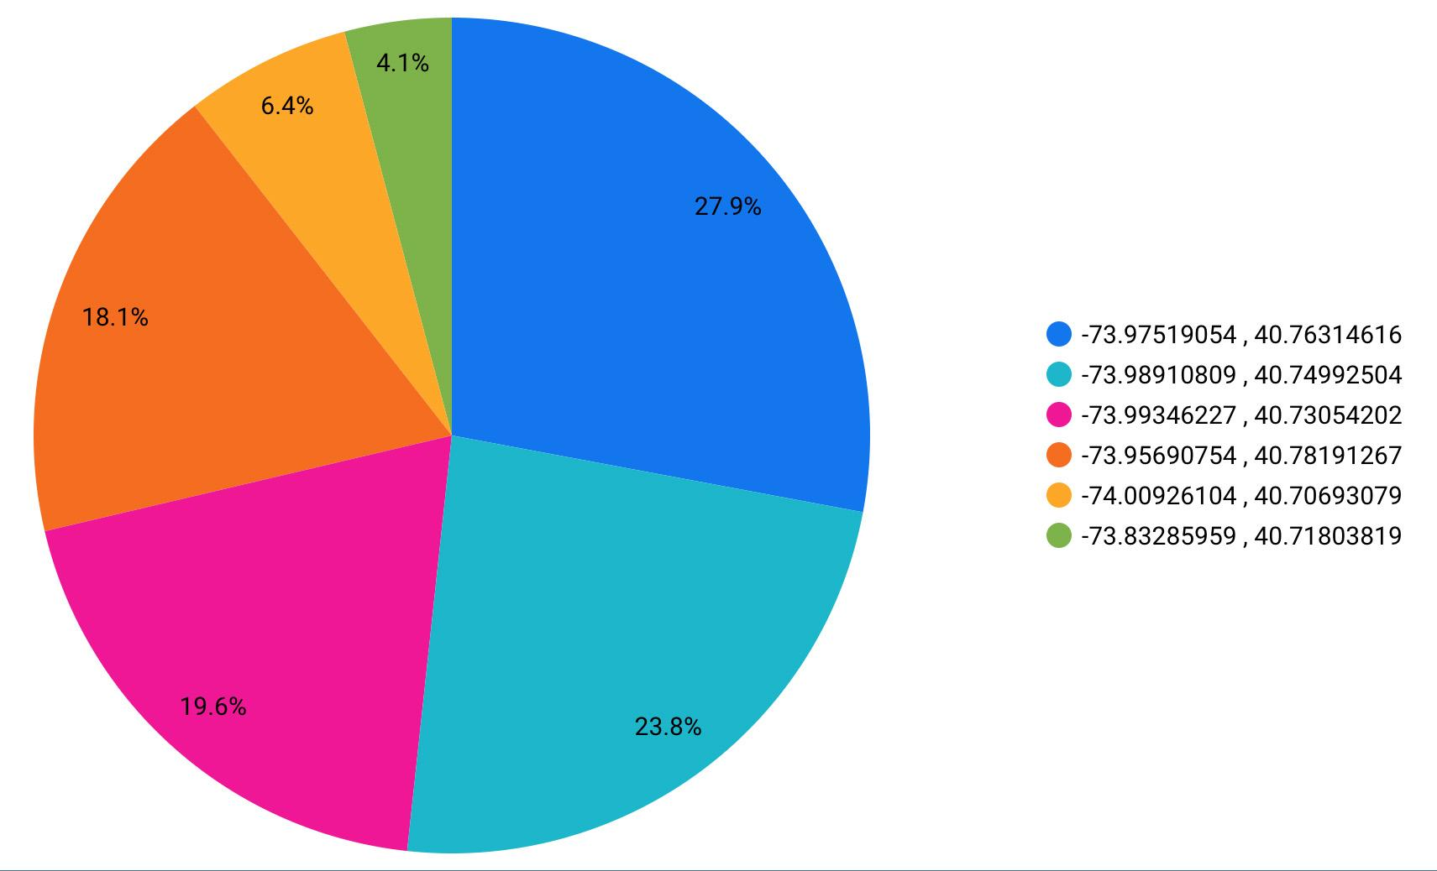
High Demand UBER Areas (AWS)
Notes:
Media support Gov.

Slide 12
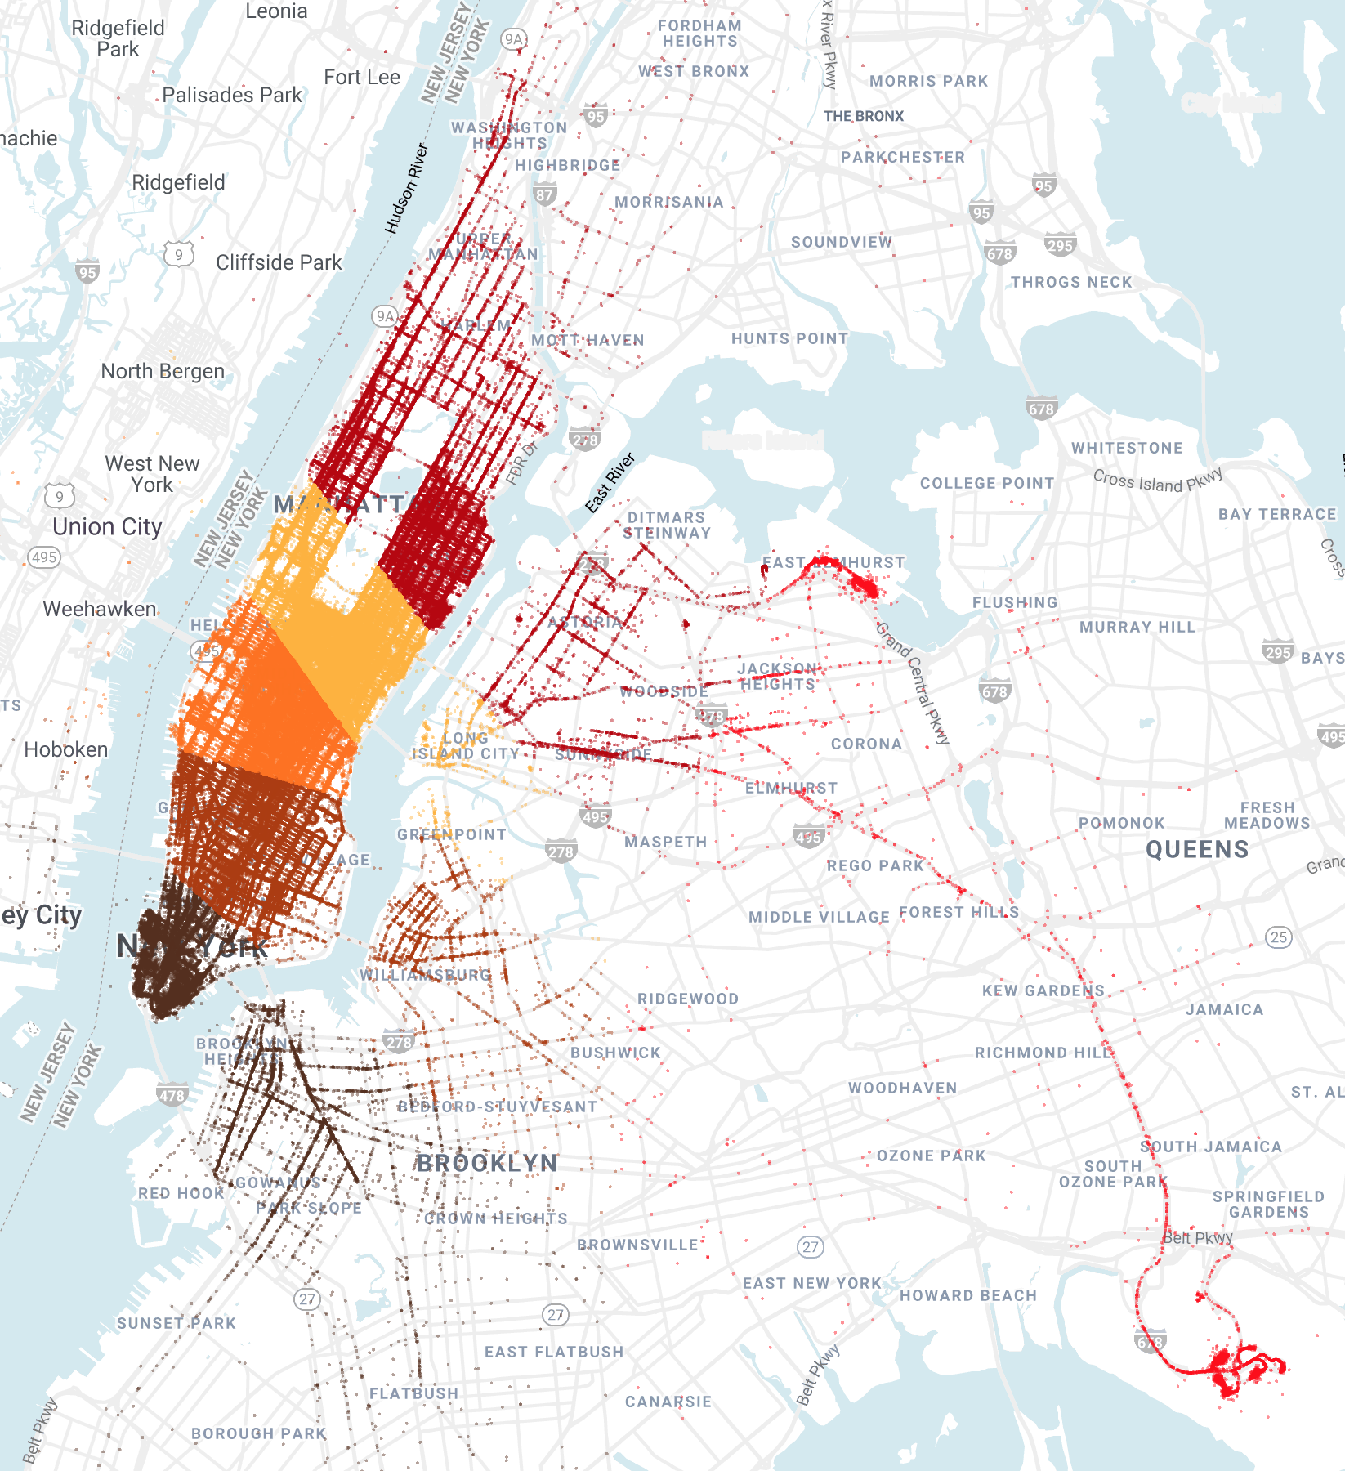
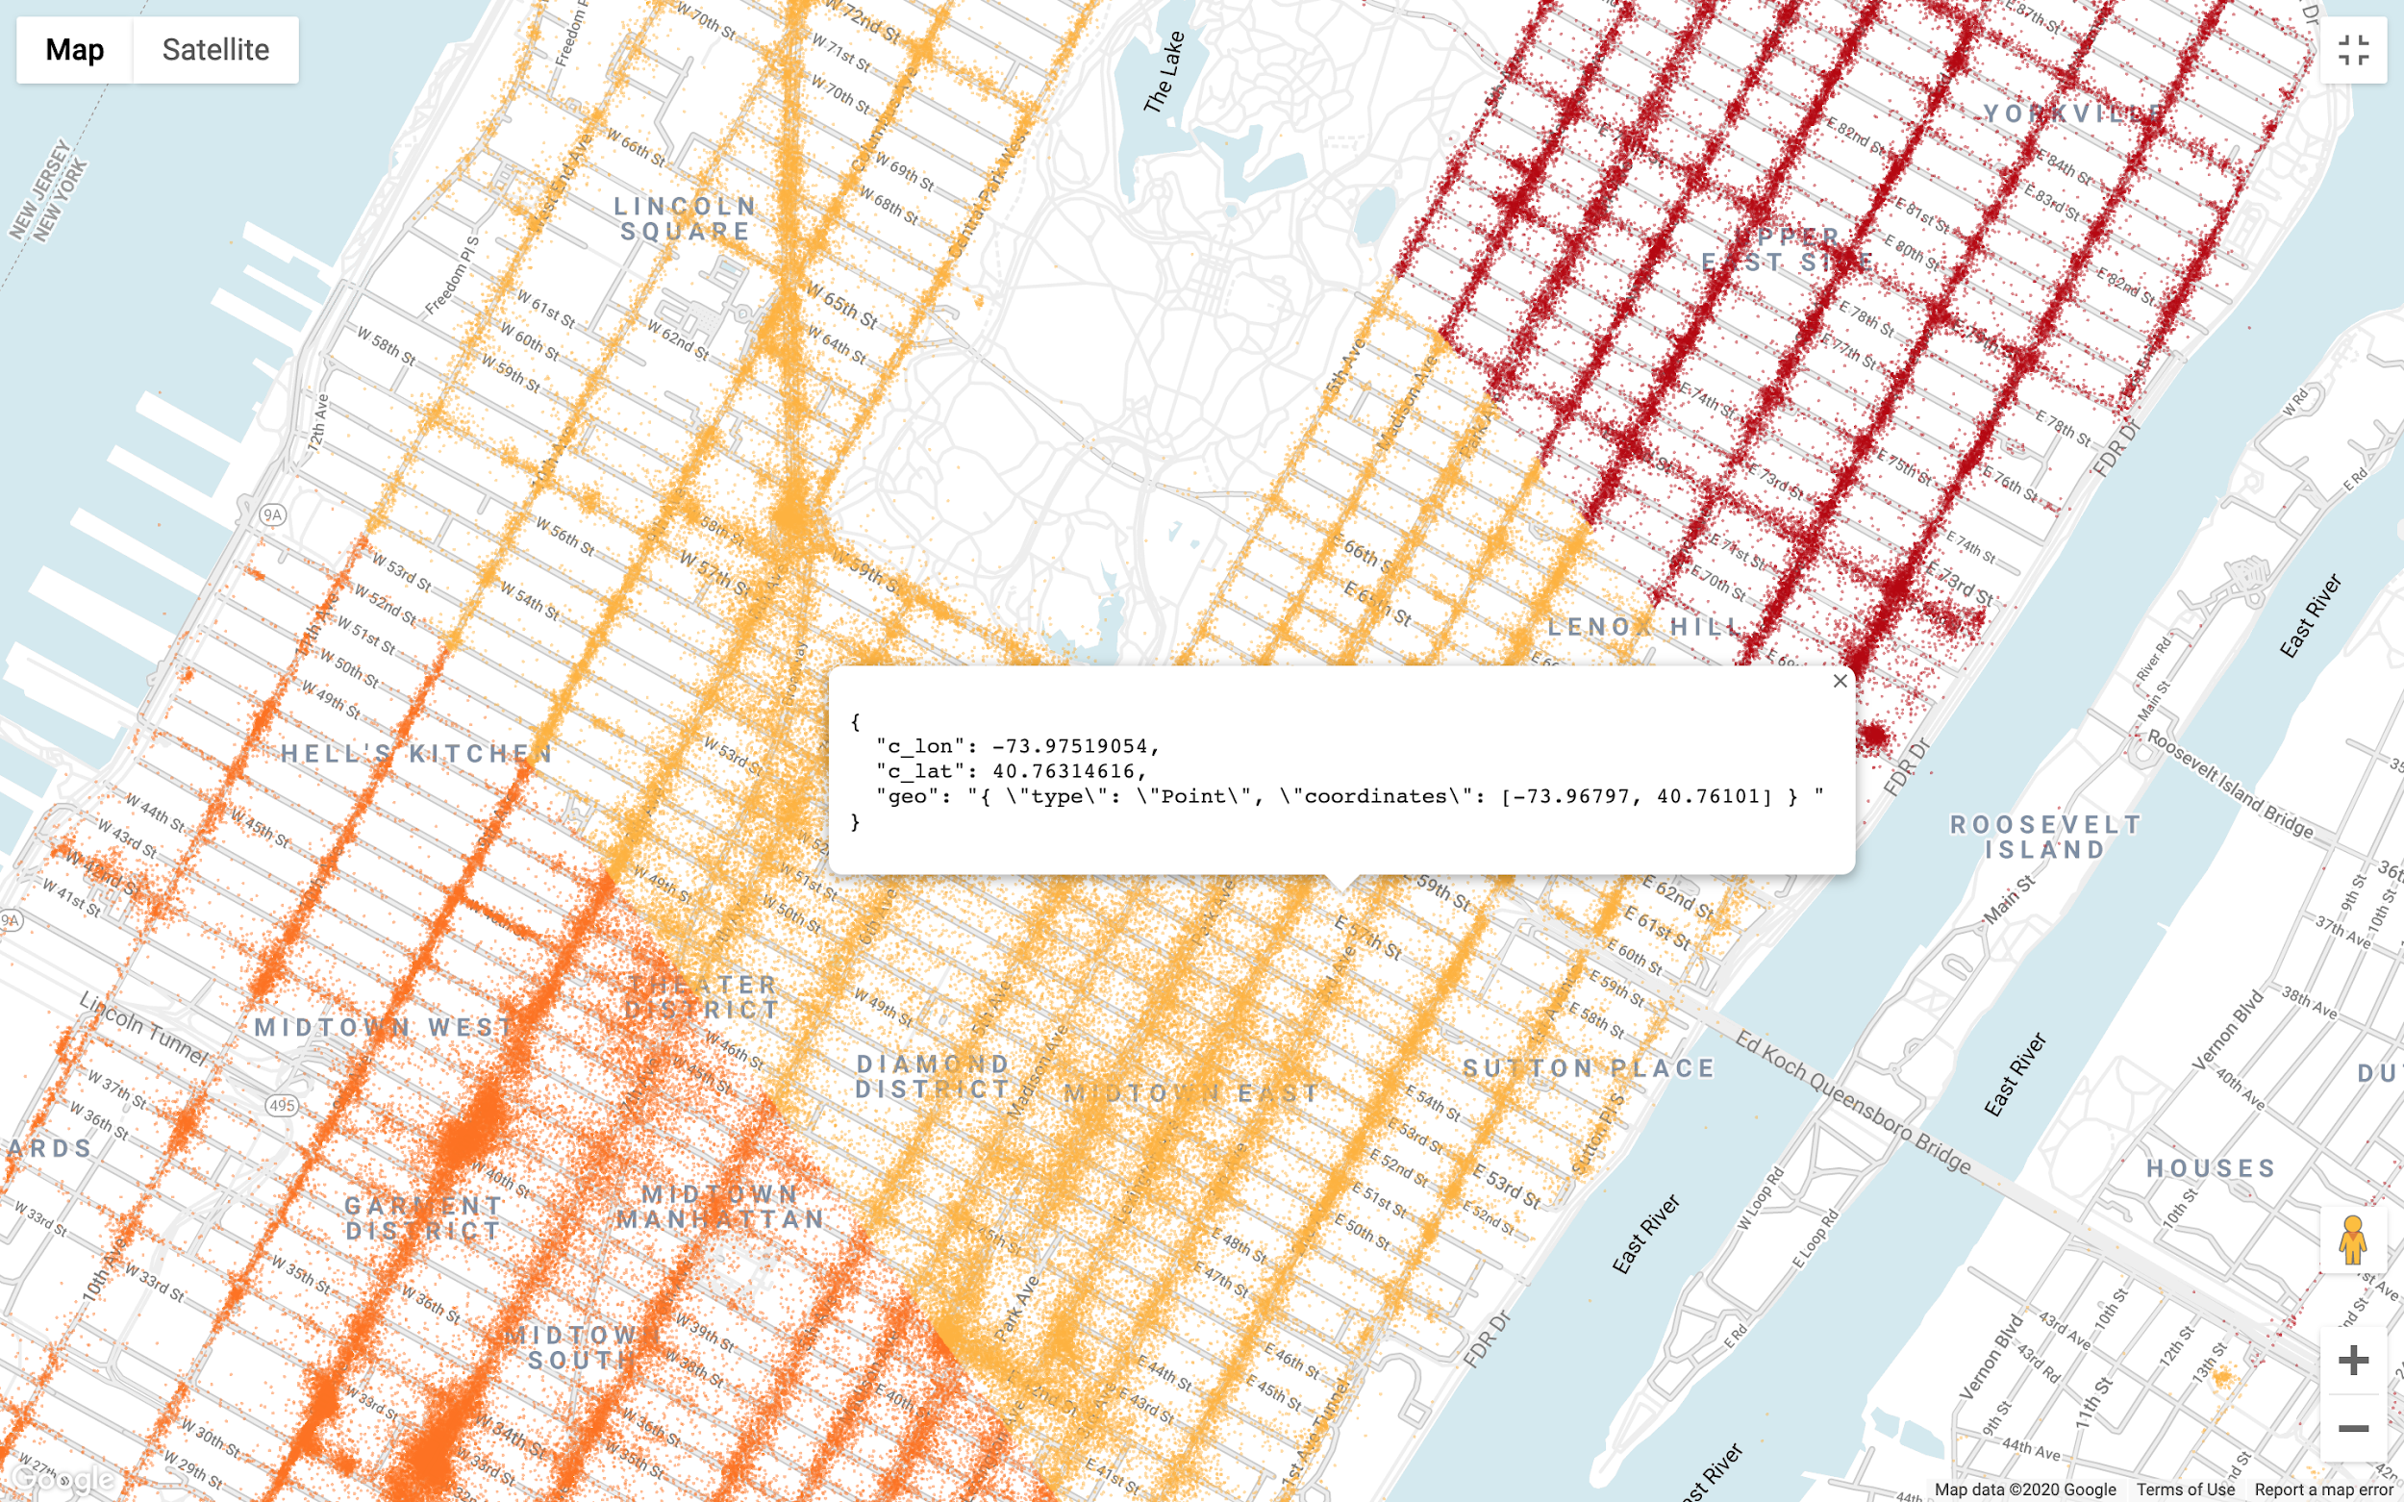
GeoViz Data Visualization
For clearer visualization,
we have used BigQuery GeoViz

Slide 13
Q&A

Slide 14
THANK YOU

